Slide 1
FLIP ROBO TECHNOLOGIES INTERNSHIP ASSIGNMENT
E-retail factors for customer activation and retention: A case study from Indian e-commerce customers
SUBMITTED BY-: ABHISHEK KUMAR
BATCH- DS0622

Slide 2
INTRODUCTION
Customer satisfaction has emerged as one of the most important factors that guarantee the success of online store; it has been posited as a key stimulant of purchase, repurchase intentions and customer loyalty.
A comprehensive review of the literature, theories and models have been carried out to propose the models for customer activation and customer retention.
Five major factors that contributed to the success of an e-commerce store have been identified as: service quality, system quality, information quality, trust and net benefit.
The research furthermore investigated the factors that influence the online customers repeat purchase intention. The combination of both utilitarian value and hedonistic values are needed to affect the repeat purchase intention (loyalty) positively.

Slide 3
Conceptual Background of the Domain Problem
The data is collected from the Indian online shoppers. Results indicate the e-retail success factors, which are very much critical for customer satisfaction.
Five major factors that contributed to the success of an e-commerce store have been identified as: service quality, system quality, information quality, trust and net benefit.
The research furthermore investigated the factors that influence the online customers repeat purchase intention.

Slide 4
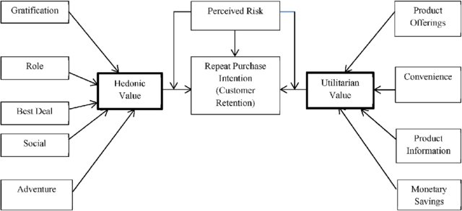
Diagrammatic Representation of Customer Retention

Slide 5
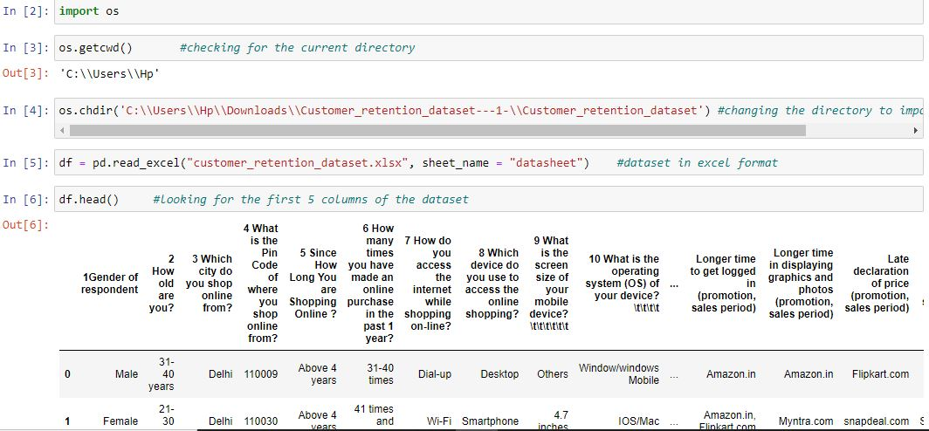
Data Sources and their formats
The data is been given by a highly-confidential company and they gave it to us in an excel file.
They also had provided the problem statement by explaining what they need from us and also the required criteria to be satisfied.
Let’s check the data now. I have attached the snapshot below to give an overview.
There are totally 269 rows and 71 columns in this dataset
Our objective is to find the insights of the data and to do thorough data analysis.

Slide 6
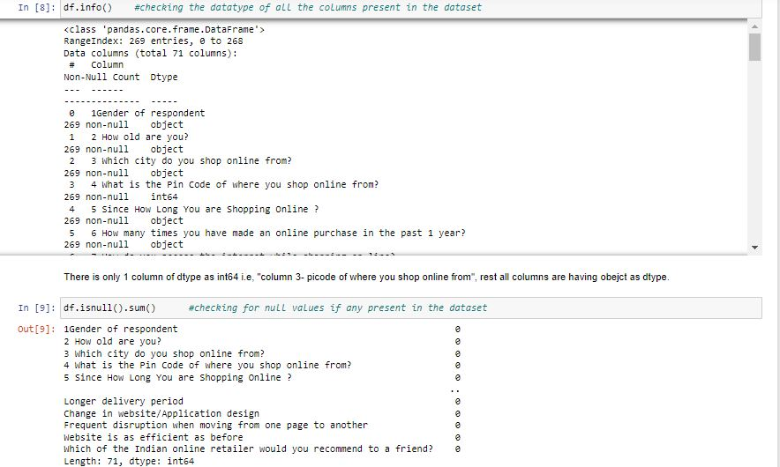
DATA ANALYSIS

Slide 7
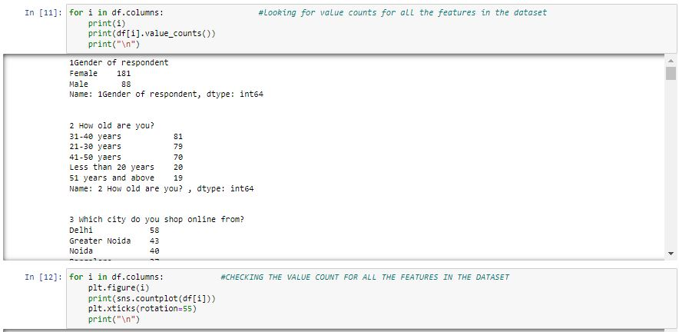
EXPLORATORY DATA ANALYSIS

Slide 8
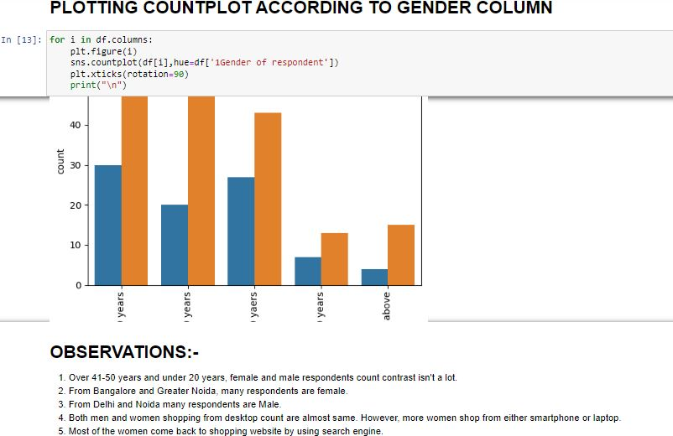
PLOTTING COUNTPLOT ACCORDING TO GENDER

Slide 9
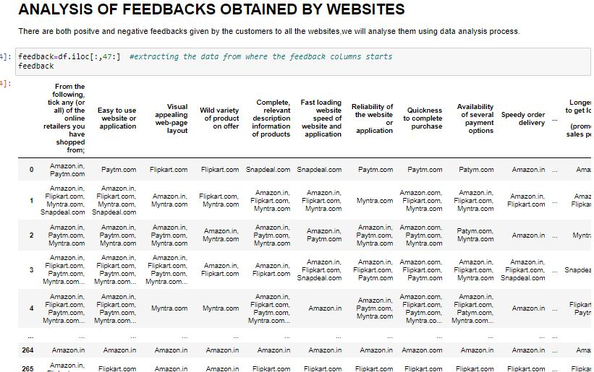
ANALYSIS OF FEEDBACK OBTAINED FROM WEBSITES

Slide 10
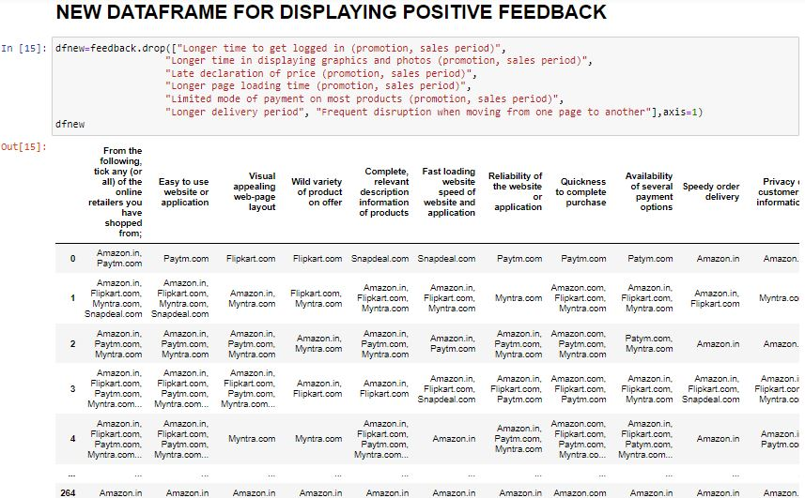
NEW DF FOR DISPLAYING POSITIVE FEEDBACK

Slide 11
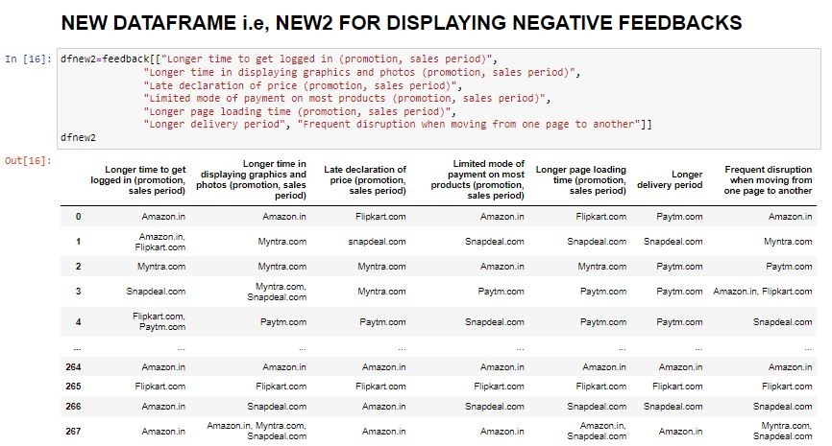
NEW DF FOR DISPLAYING –VE FEEDBACK

Slide 12
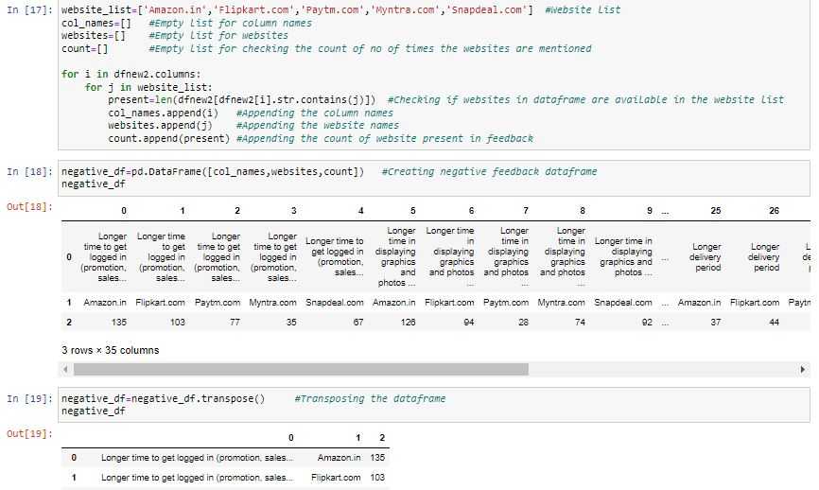
ANALYSING THE –VE FEEDBACKS, CREATING DF AND TRANSPOSING THE DF

Slide 13
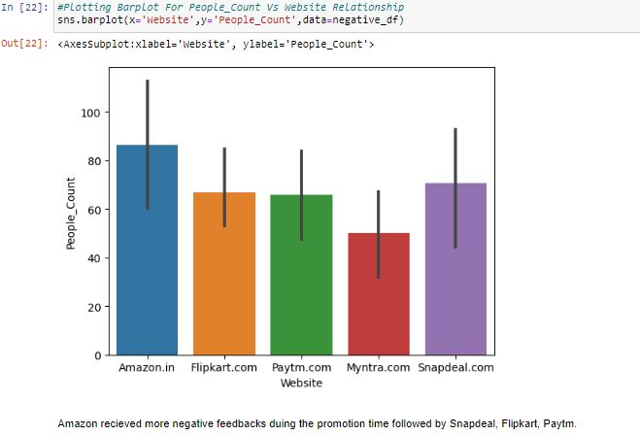
DATA VISUALIZATION

Slide 14
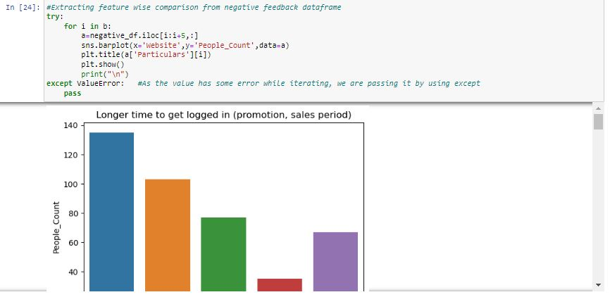
EXTRACTING FEATURE WISE COMAPRISON FROM –VE FEEDBACK

Slide 15
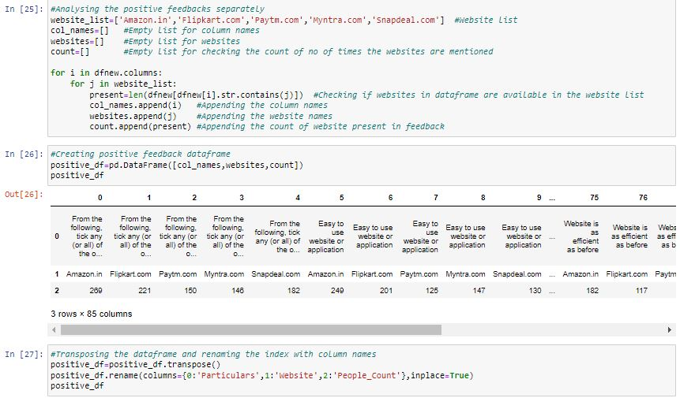
ANALYSING +VE FEEDBACK SEPARATELY, CREATING DF AND TRANPOSING

Slide 16
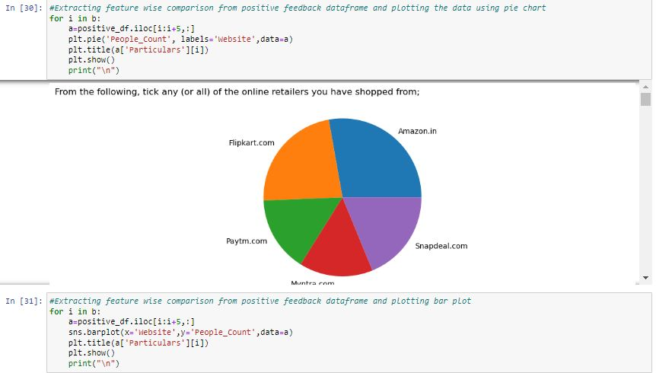
EXTRACTING FEATURE WISE COMPARISON FROM +VE FEEDBACK

Slide 17
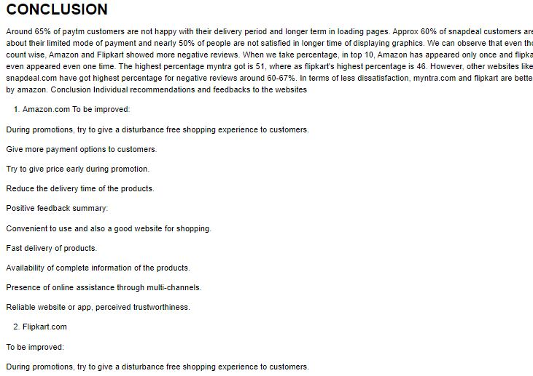
CONCLUSIONS

